Slide 1

CSE 591 Trees and Hierarchies
Ross Maciejewski
rmacieje@asu.edu

Slide 2
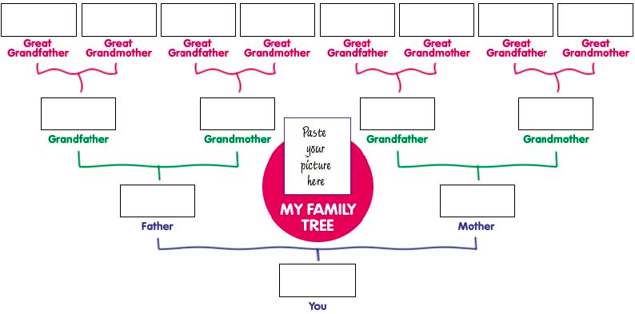
Hierarchies
Definition
Data repository in which cases are related to subcases
Can be thought of as imposing an ordering in which cases are parents or ancestors of other cases
Parts of this slide borrowed from John Stasko’s Information Visualization Course Lecture: Hierarchies and Trees 1(Node-Link): http://www.cc.gatech.edu/~stasko/7450/11s/Talks/tree1.pdf

Slide 3
Trees
In the last lectures we’ve been discussing Graphs
Hierarchies are often represented as trees
Directed
Acyclic
Two main representation schemes
Node-link (this is similar to the graphical representations we’ve discussed earlier)
Space-Filling

Slide 4
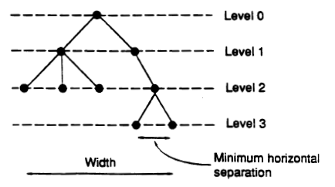
Rooted Trees
A graph might be used to represent some hierarchy, so we often utilize a tree metaphor
Typically these utilize the following aesthetics
Vertices are placed along horizontal lines according to their level (distance from root)
There is a minimum separation distance between two consecutive vertices on the same level
The width of the drawing is as small as possible
P Eades and R Tamassia, “Algorithms for Drawing Graphs: An Annotated Bibliography,” Technical Report No. CS-89-09, Brown University, October 1989.

Slide 5
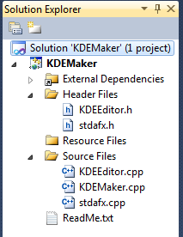
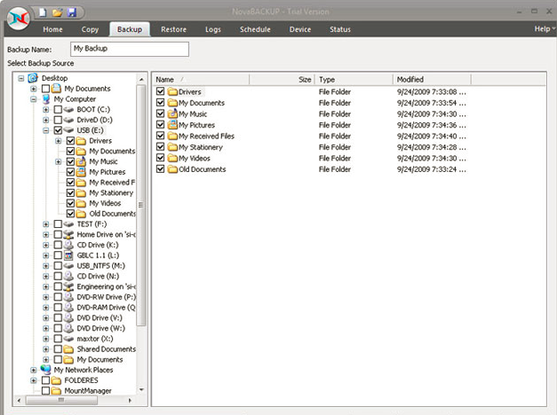
Using Rooted Trees
What are such sorts of structures useful for?

Slide 6
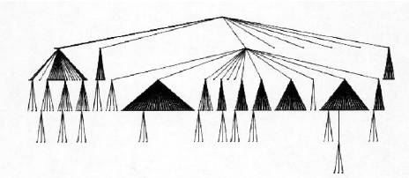
Top-Down Approach
Width of fan-out uses up horizontal real estate very quickly
At level n, there are 2^{n} nodes
Tree may grow very long in one branch
Essentially you can wind up leaving a lot of screen real estate empty
Parts of this slide borrowed from John Stasko’s Information Visualization Course Lecture: Hierarchies and Trees 1(Node-Link): http://www.cc.gatech.edu/~stasko/7450/11s/Talks/tree1.pdf

Slide 7
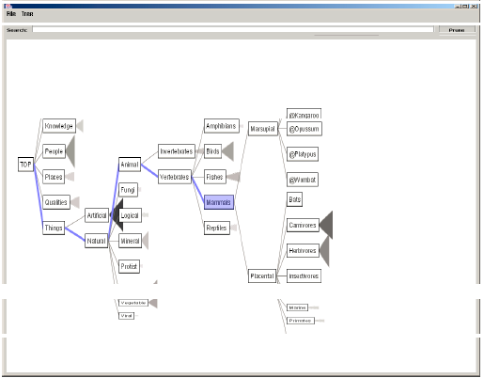
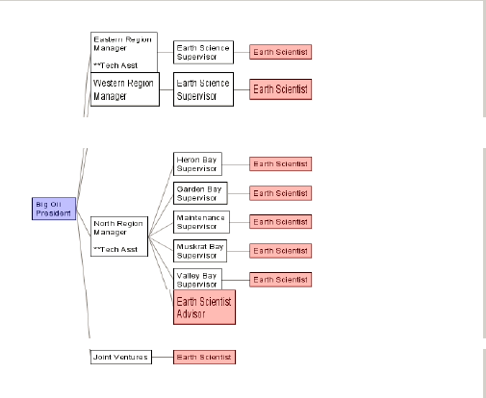
Space Tree
Visualization techniques try to overcome some of these issues in node link tree diagrams
Space Tree by Plaisant et al.
Dynamic rescaling of branches to best fit available screen space
Utilized preview icons to summarize branch topology
Plaisant, C.; Grosjean, J.; Bederson, B.B.; , "SpaceTree: supporting exploration in large node link tree, design evolution and empirical evaluation," IEEE Symposium on Information Visualization, pp. 57- 64, 2002

Slide 8
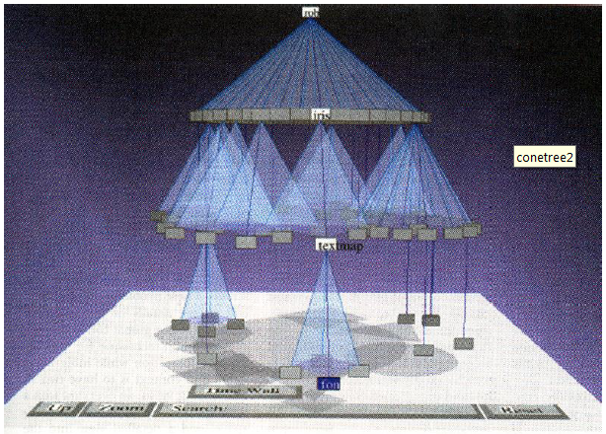
Cone Trees
Add a third dimension for the layout
Children of a node are laid out in a cylinder below the parent
Siblings live in one of the 2D planes
Robertson, G. G. Mackinlay, J. D. Card, S. K. Cone Trees: animated 3D visualizations of hierarchical information, Proc. Human factors in computing systems conference, March 1991, 189-194.

Slide 9
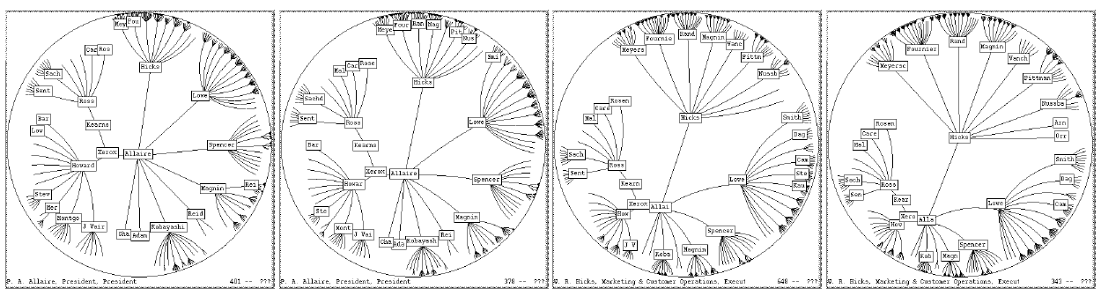
Hyperbolic Trees
We don’t have to constrain ourselves to the top-down geometry approach
We can apply a hyperbolic transformation to the space
Distance between parent and child decreases as you move farther from the center
Children go in a wedge rather than a circle
Lamping, J., Rao, R., Pirolli; P. (1995) A focus+context technique based on hyperbolic geometry for visualizing large hierarchies Conference proceedings on Human factors in computing systems, 1995, 401-408

Slide 10
Node-Link Shortcomings
Difficult to encode more variables of data cases
Shape
Size
Color
All of these can clash with the basic node-link structure
Parts of this slide borrowed from John Stasko’s Information Visualization Course Lecture: Hierarchies and Trees 2(Space Filling): http://www.cc.gatech.edu/~stasko/7450/Notes/tree2.pdf

Slide 11
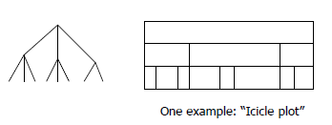
Space-Filling Representation
Each item now occupies an area
Children are contained under the parent
Parts of this slide borrowed from John Stasko’s Information Visualization Course Lecture: Hierarchies and Trees 2(Space Filling): http://www.cc.gatech.edu/~stasko/7450/Notes/tree2.pdf

Slide 12
Treemap
Space filling representation developed by Johnson and Shneiderman
Children are drawn inside their parent
Alternate horizontal and vertical slicing at each successive level
Use area to encode other variable of data items
Johnson, B. and Shneiderman, B. Treemaps: A Space-Filling Approach to the Visualization of Hierarchical Information Structures. In Proceedings of the IEEE Information Visualization ’91, pages 275–282, IEEE, 1991.

Slide 13
Treemap Algorithm
Draw()
{
1) Change orientation from parent (horiz/vert)
2) Read all files and directories at this level
3) Make rectangles for each, scaled to size
4) Draw rectangles using appropriate size and color
5) For each directory
a) Make recursive call using its rectangle as focus
}
Parts of this slide borrowed from John Stasko’s Information Visualization Course Lecture: Hierarchies and Trees 2(Space Filling): http://www.cc.gatech.edu/~stasko/7450/Notes/tree2.pdf

Slide 14
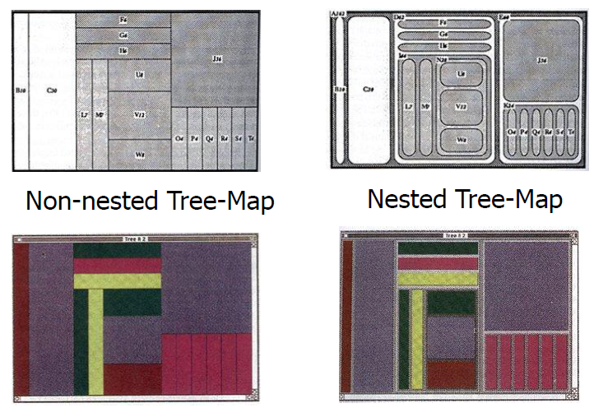
Nested vs. Non-Nested
Parts of this slide borrowed from John Stasko’s Information Visualization Course Lecture: Hierarchies and Trees 2(Space Filling): http://www.cc.gatech.edu/~stasko/7450/Notes/tree2.pdf

Slide 15
Treemap Applications
Can use the Treemap idea in a variety of domains
File/directory structures
Software diagrams
Sports analysis
Stock market data
Examples
http://www.smartmoney.com/map-of-the-market/
http://www.nytimes.com/packages/html/newsgraphics/2011/0119-budget/
http://www.wired.com/wiredscience/2008/06/awesome-infogra/
Parts of this slide borrowed from John Stasko’s Information Visualization Course Lecture: Hierarchies and Trees 2(Space Filling): http://www.cc.gatech.edu/~stasko/7450/Notes/tree2.pdf

Slide 16
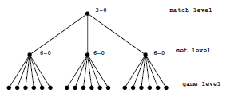
Visualizing a Tennis Match
Analyze, review and browse a tennis match
Space-filling/treemap-like hierarchy to show a competition tree
Show match, sets, game points
Lens can show shot patterns
Color encodes player
Liqun Jin and David C. Banks, ``TennisViewer: a Browser for Competition Trees,'' IEEE Computer Graphics & Applications, Vol. 21, No. 2 (March/April 1997), pergamon Press, pp. 171-178.

Slide 17
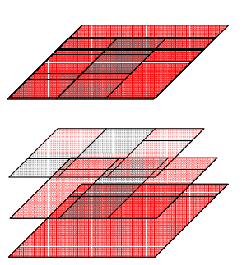
Visualizing a Tennis Match
Composite
Games
Set
Match
Liqun Jin and David C. Banks, ``TennisViewer: a Browser for Competition Trees,'' IEEE Computer Graphics & Applications, Vol. 21, No. 2 (March/April 1997), pergamon Press, pp. 171-178.

Slide 18
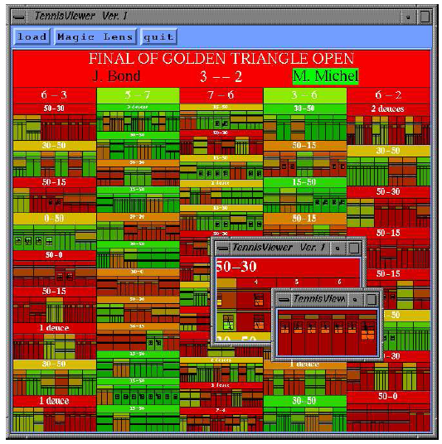
Visualizing a Tennis Match
Liqun Jin and David C. Banks, ``TennisViewer: a Browser for Competition Trees,'' IEEE Computer Graphics & Applications, Vol. 21, No. 2 (March/April 1997), pergamon Press, pp. 171-178.

Slide 19
Treemap Benefits
Good representation of two attributes beyond node-link: color and area
Not quite as good at representing structure
For example, what happens if the tree is perfectly balanced?
Can also get long-thin aspect ratios
Borders can help on small trees, but take up too much area on large, deep trees
Parts of this slide borrowed from John Stasko’s Information Visualization Course Lecture: Hierarchies and Trees 2(Space Filling): http://www.cc.gatech.edu/~stasko/7450/Notes/tree2.pdf

Slide 20
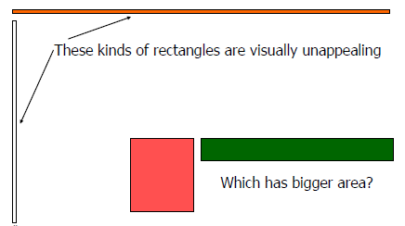
Aspect Ratios
Previous lectures, we discussed Cleveland’s “Banking to 45”
Here, the aspect ratio will drastically affect the visualization
Parts of this slide borrowed from John Stasko’s Information Visualization Course Lecture: Hierarchies and Trees 2(Space Filling): http://www.cc.gatech.edu/~stasko/7450/Notes/tree2.pdf

Slide 21
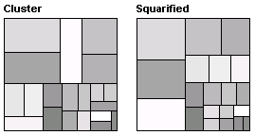
Clustered and Squarified Treemaps
http://smartmoney.com/marketmap
This treemap differs from the original version in that it uses a simple recursive algorithm to reduce the overall aspect ratio
Bruls et al. introduced the squarified treemap which utilized a different algorithm to also try and attempt to better utilize the aspect ratio
1 -Wattenberg, M. “Visualizing the Stock Market,” Proceedings of ACM CHI 99, Extended Abstracts, pp.188-189, 1999.
2 -Bruls, D.M., C. Huizing, J.J. van Wijk. “Squarified Treemaps”. In: W. de Leeuw, R. van Liere (eds.), Data Visualization 2000, Proceedings of the joint Eurographics and IEEE TCVG Symposium on Visualization, 2000, pp. 33-42.

Slide 22
Clustered and Squarified Treemaps
Methods had two major drawbacks
Changes in the set can cause discontinuities in the layout
If treemap data is dynamic (as in the stockmarket) large visual changes make the data hard to track
If the data has ordering information (for example bond data can be ordered by maturity) this is not preserved
1 -Wattenberg, M. “Visualizing the Stock Market,” Proceedings of ACM CHI 99, Extended Abstracts, pp.188-189, 1999.
2 -Bruls, D.M., C. Huizing, J.J. van Wijk. “Squarified Treemaps”. In: W. de Leeuw, R. van Liere (eds.), Data Visualization 2000, Proceedings of the joint Eurographics and IEEE TCVG Symposium on Visualization, 2000, pp. 33-42.

Slide 23
Ordered Treemap
Shneiderman and Wattenberg introduced the ordered treemap to try and overcome these limitations
Key insight is that it’s possible to create a layout in which items that are next to each other in the given order are adjacent in the tree map
Presented two algorithms for ordering a treemap
Ben Shneiderman, Martin Wattenberg: Ordered Treemap Layouts. INFOVIS 2001: 73-78

Slide 24
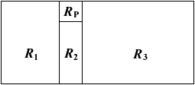
Ordered Treemap Algorithm
Starting with a rectangle R to be subdivided, first algorithm pivot-by-size, the pivot is the item with the largest area
Let P, the pivot, be the item with the largest area in the list of items
If the width R is greater than or equal to the height, divide R into four rectangle
Place P in the rectangle R_{p}
Divide the items in the list, other than P, into three lists, L₁, L₂, L₃ to be laid out in R₁, R₂ and R₃.
Recursively lay out L₁, L₂ and L₃ in R₁, R₂ and R₃
Ben Shneiderman, Martin Wattenberg: Ordered Treemap Layouts. INFOVIS 2001: 73-78

Slide 25
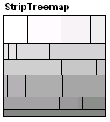
Strip Treemaps
Looks only at rectangles within the strip currently being processed
Scale the area of all the rectangles so that the total area of the input rectangles equals that of the layout rectangle
Create a new empty strip, the current strip
Add the next rectangle to the current strip, recomputing the height of the strip based on the area of all the rectangles within the strip and recomputing the width of each rectangle
If the average aspect ratio of the current strip has increased as a result of adding the rectangle in step 3, remove the rectangle pushing it back onto the list of rectangles and go to step 2
If all rectangles have been processed stop, else step 3
Benjamin B. Bederson, Ben Shneiderman, Martin Wattenberg: Ordered and quantum treemaps: Making effective use of 2D space to display hierarchies. ACM Trans. Graph. 21(4): 833-854 (2002)

Slide 26
Metrics For Treemaps
In order to assess all these different treemap algorithms, we need metrics to define how “good” they are
Use two metrics:
Average aspect ratio of treemap layout
Layout distance change function
Goal is to have low average aspect ratio and a low distance change as data is updated
Average aspect ratio is the unweighted average
Distance change is Euclidian distance of change in width height and corner location of rectangles

Slide 27
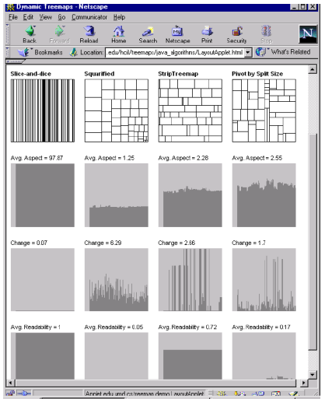

Slide 28
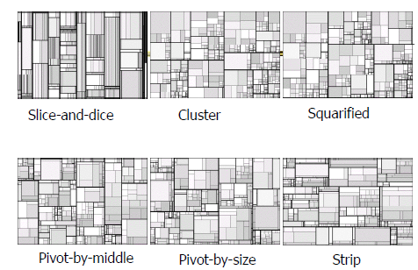

Slide 29
Showing Structure
Regular borderless treemap makes it challenging to discern structure of hierarchy, particularly large ones
Supplement treemap view
Change rectangles to other forms
http://marumushi.com/projects/newsmap
Parts of this slide borrowed from John Stasko’s Information Visualization Course Lecture: Hierarchies and Trees 2(Space Filling): http://www.cc.gatech.edu/~stasko/7450/Notes/tree2.pdf

Slide 30
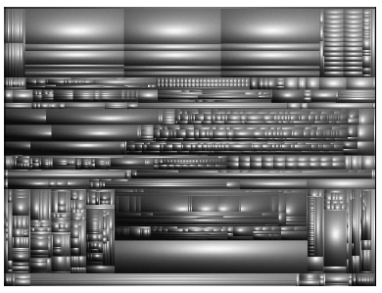
Cushion Treemap
Use shading and texture to help convey structure of hierarchy
Van Wijk, J.J.; Van de Wetering, H. (1999), "Cushion treemaps: visualization of hierarchical information", Proc. IEEE Symp. Information Visualization (Info Vis '99), pp. 73–78

Slide 31
Another Problem
What if nodes with zero value are very important?
If we’re mapping areas, how do we map to zero
Example: Stocks portfolios, I want to know what I’m not invest in because I may potentially invest
Parts of this slide borrowed from John Stasko’s Information Visualization Course Lecture: Hierarchies and Trees 2(Space Filling): http://www.cc.gatech.edu/~stasko/7450/Notes/tree2.pdf

Slide 32
Context Treemap
One way to overcome this is to distort the classic treemap visualization
Distorted treemap can show one more attribute than a classic treemap, but node area is no longer proportional to the attribute being visualized
Several different implementation strategies for this
Use a regular tree map but add some epsilon to zero value items
Unfortunately, as tree grows this causes things to get squished
Use an exponential mapping area(node)=2^(value(node))
Assign some minimal screen space size to zero nodes
Christoph Csallner, Marcus Handte, Othmar Lehmann, John T. Stasko: FundExplorer: Supporting the Diversification of Mutual Fund Portfolios Using Context Treemaps. INFOVIS 2003: 203-208

Slide 33

Context Treemap
Final solution was to calculate intermediate values
Calculate the total (in this paper it was total invest money)
Value(total)
Create an additional total with respect to the context
Value(total)*v, where v can be modified as a scale factor
Split context screen real estate among all empty nodes
Value_{c} = value(total)*v/#empty
Christoph Csallner, Marcus Handte, Othmar Lehmann, John T. Stasko: FundExplorer: Supporting the Diversification of Mutual Fund Portfolios Using Context Treemaps. INFOVIS 2003: 203-208

Slide 34
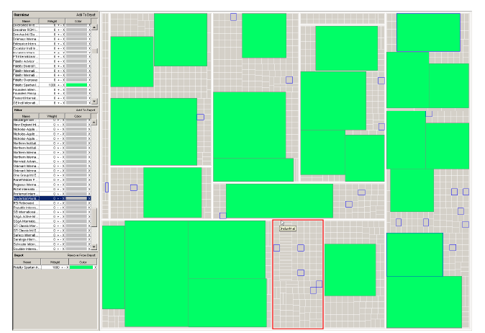
Christoph Csallner, Marcus Handte, Othmar Lehmann, John T. Stasko: FundExplorer: Supporting the Diversification of Mutual Fund Portfolios Using Context Treemaps. INFOVIS 2003: 203-208

Slide 35
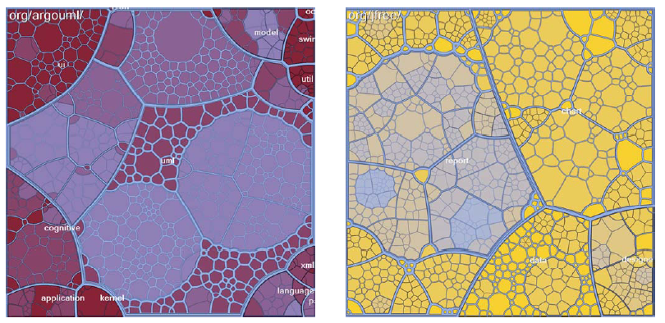
Voronoi Treemaps
Michael Balzer, Oliver Deussen, and Claus Lewerentz. 2005. Voronoi treemaps for the visualization of software metrics. In Proceedings of the 2005 ACM symposium on Software visualization (SoftVis '05)

Slide 36
Definition of Voronoi Diagram
Let P be a set of n distinct points (sites) in the plane.
The Voronoi diagram of P is the subdivision of the plane into n cells, one for each site.
A point q lies in the cell corresponding to a site p_{i} ∈ P iff Euclidean_Distance( q, p_{i} ) < Euclidean_distance( q, p_{j} ), for each p_{i} ∈ P, j ≠ i.
Main Algorithm is Fortune’s Algorithm
Steven Fortune. A sweepline algorithm for Voronoi diagrams. Proceedings of the second annual symposium on Computational geometry. Yorktown Heights, New York, United States, pp.313–322. 1986

Slide 37
Summary of Voronoi Properties
A point q lies on a Voronoi edge between sites p_{i} and p_{j} iff the largest empty circle centered at q touches only p_{i} and p_{j}
A Voronoi edge is a subset of locus of points equidistant from p_{i} and p_{j}
p_{i} : site points
e : Voronoi edge
v : Voronoi vertex
v
p_{i}
e

Slide 38
Summary of Voronoi Properties
A point q is a vertex iff the largest empty circle centered at q touches at least 3 sites
A Voronoi vertex is an intersection of 3 more segments, each equidistant from a pair of sites
p_{i} : site points
e : Voronoi edge
v : Voronoi vertex
v
p_{i}
e

Slide 39
Voronoi diagrams have linear complexity {|v|, |e| = O(n)}
Intuition: Not all bisectors are Voronoi edges!
p_{i} : site points
e : Voronoi edge
p_{i}
e

Slide 40
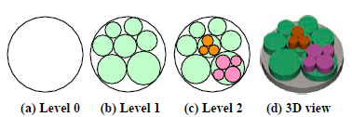
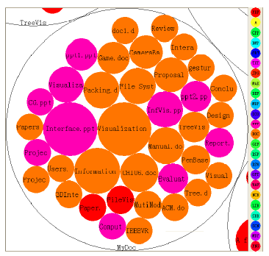
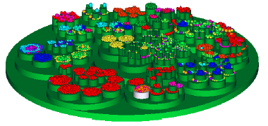
Circle Packing
Weixin Wang, Hui Wang, Guozhong Dai, and Hongan Wang. 2006. Visualization of large hierarchical data by circle packing. In Proceedings of the SIGCHI conference on Human Factors in computing systems (CHI '06), pg. 517-520.

Slide 41
Readings and Homework
Required Reading:
B. Johnson and B. Shneiderman, "Tree-maps: A Space Filling Approach to the Visualization of Hierarchical Information Structures", Proc. of Vis '91, Oct. 1991, pp. 284-291.
B. Bederson, B. Shneiderman, and M. Wattenberg, Ordered and Quantum Treemaps: Making Effective Use of 2D Space to Display Hierarchies, ACM Trans. on Graphics, Vol. 21, No. 4, Oct. 2002, pp. 833-854.
Perceptual Guidelines for Creating Rectangular Treemaps, Nicholas Kong, Jeffrey Heer and Maneesh Agrawala. IEEE Transactions on Visualization and Computer Graphics (Proc. InfoVis'10), Oct 2010.
Homework
Assignment #6 is due in ~1.5 weeks.

